Slide 1

Lecture 8
Inference using χ² distribution

Slide 2
Benford’s Law says that the “expected” proportion of digits starting with d should be equal to log₁₀(1 + 1/d)
Benford’s Law applies to many lists
Example: Population for n=233 countries, 2016
First digit | 1 | 2 | 3 | 4 | 5 | 6 | 7 | 8 | 9
Predicted # | 70.1 | 41.0 | 29.1 | 22.6 | 18.4 | 15.6 | 13.5 | 11.9 | 10.7
Actual # | 69 | 35 | 32 | 21 | 27 | 12 | 13 | 13 | 11

Slide 3
In 1992, Wayne James Nelson wrote a series of 23 checks totaling $1.9M
$ 1,927.48
10/9/92 7,902.31
86,241.90
72,117.46
81,321.75
10/14/92 97,473.96
93,249.11
89,658.17
87,776.89
92,105.83
79,949.16
87,602.93
96,879.27
91,806.47
84,991.67
90,831.83
93,766.67
88,338.72
94,639.49
83,709.28
96,412.21
88,432.86
10/19/92 71,552.16
$ 1,878,687.58

Slide 4
In 1992, Wayne James Nelson wrote a series of 23 checks totaling $1.9M
The first digits of the checks did not seem to follow Benford’s Law
Could the difference in counts be due to luck? How can we tell?
$ 1,927.48
10/9/92 7,902.31
86,241.90
72,117.46
81,321.75
10/14/92 97,473.96
93,249.11
89,658.17
87,776.89
92,105.83
79,949.16
87,602.93
96,879.27
91,806.47
84,991.67
90,831.83
93,766.67
88,338.72
94,639.49
83,709.28
96,412.21
88,432.86
10/19/92 71,552.16
$ 1,878,687.58
First digit | 1 | 2 | 3 | 4 | 5 | 6 | 7 | 8 | 9
Pred. # | 6.9 | 4.1 | 2.9 | 2.2 | 1.8 | 1.5 | 1.3 | 1.2 | 1.1
Actual # | 1 | 1 | 0 | 0 | 0 | 0 | 3 | 9 | 9

Slide 5
Lecture 8: Inference using χ² distribution
The chi-square (χ²) random variable
Applications of χ² to statistical inference
The χ² test of independence
The χ² “goodness of fit” test
Inference for standard deviation of a normal population

Slide 6
Lecture 8: Inference using χ² distribution
The chi-square (χ²) random variable
Applications of χ² to statistical inference
The χ² test of independence
The χ² “goodness of fit” test
Inference for standard deviation of a normal population

Slide 7
The chi-square (χ²) distribution (1/2)
Define Z ~ standard normal random variable (i.e., μ = 0, σ = 1). Then C₁ = Z² has a chi-square (χ²) distribution with 1 degree of freedom
C₁ has a minimum of 0
68% of Z-values will be between –1 and 1, so 68% of C₁ values will be between 0 and 1
5% of Z-values will be less than –2 or greater than 2; so 5% of C₁ values will be greater than 4
It can be shown that E(C₁) = 1, SE(C₁) = sqrt(2)

Slide 8
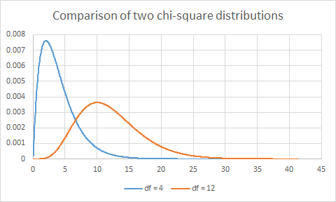
The chi-square (χ²) distribution (2/2)
Define Z₁, Z₂, … , Z_{k} ~ k independent standard normal random variables. Then C_{k} = Z₁² + Z₂² + … + Z_{k}² has a chi-square (χ²) distribution with k degree of freedom
Properties:
C_{k} > 0
E(C_{k}) = k
SE(C_{k}) = sqrt(2k)
χ²₄
χ²₁₂

Slide 9
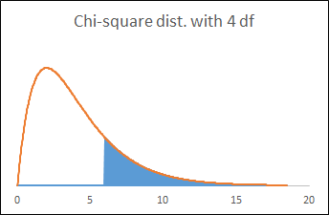
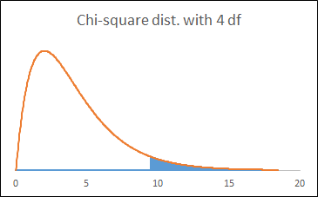
Using Excel for χ² distribution
=CHIDIST(x, [df]) gives the area to the right of x for χ²_{df}
=CHIINV(p, [df]) gives the score x such that the area to the right of x = p
=CHIDIST(6,4) → area = 0.199
=CHIINV(0.05,4) → x = 9.488

Slide 10
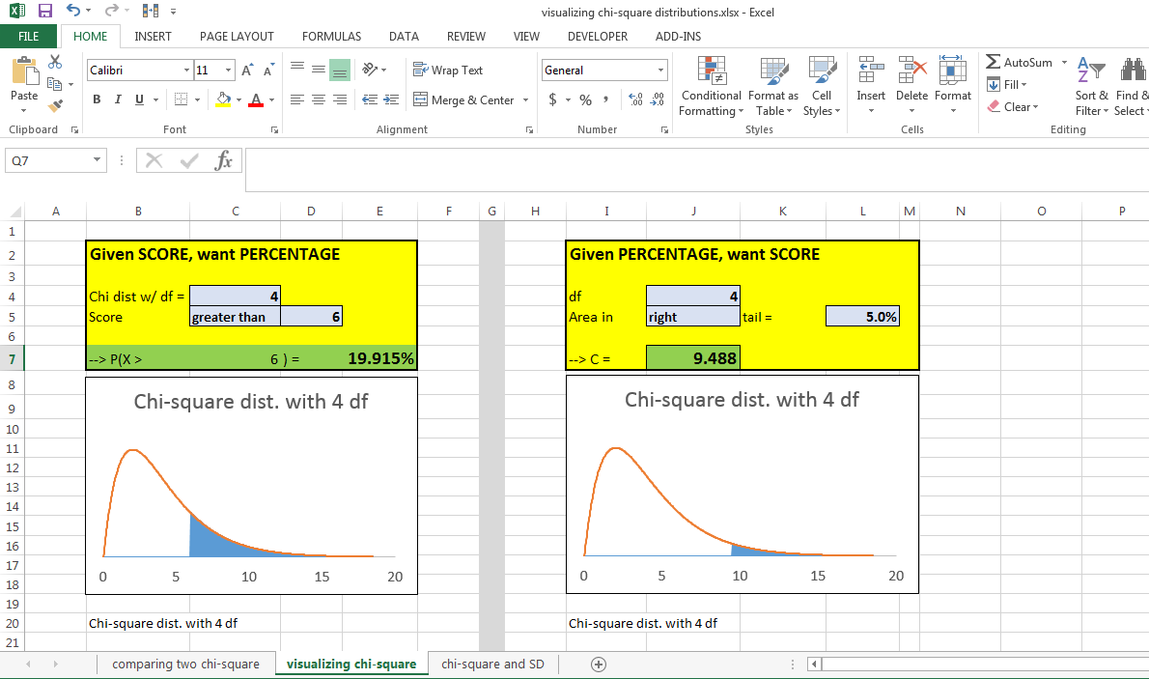
An Excel sheet has been created to perform calculations for the χ² distrib.

Slide 11
Lecture 8: Inference using χ² distribution
The chi-square (χ²) random variable
Applications of χ² to statistical inference
The χ² test of independence
The χ² “goodness of fit” test
Inference for standard deviation of a normal population

Slide 12
Lecture 8: Inference using χ² distribution
The chi-square (χ²) random variable
Applications of χ² to statistical inference
The χ² test of independence
The χ² “goodness of fit” test
Inference for standard deviation of a normal population

Slide 13
Chi-square test of independence
When to use:
You have two or more samples from various populations; each sample has two or more categories of outcomes
(Note: if you have 2x2, the chi-square test is equivalent to a two-sample Z-test for percentages, since Z² = χ²₁)
You want to know if all populations have the same distribution (i.e., chances are independent of population)

Slide 14
http://pollingreport.com/guns.htm
Quinnipiac Poll, June 2017, equivalent to a SRS of 831 registered voters:
“Do you support or oppose stricter gun laws in the United States?”
 | Support | Oppose | Unsure
Republicans (n=224) | 26.8% | 67.9% | 5.4%
Democrats (n=231) | 80.1% | 17.7% | 2.2%
Independent (n=376) | 54.3% | 42.3% | 3.5%

Slide 15
Chi-square test of independence
Performing test of independence (9 steps):
State H₀: variables are independent
Organize observed counts “O” into table
Compute overall percentage per category
Get expected values “E” based on overall %
Check that all E’s > 5; if not, group categories
Compute C = Σ (O – E)²/E
Compare C to chi-square with df = (r–1)(c–1)
Get p-value
Make conclusion, based on p-value

Slide 16
Test of independence:
H₀: independent
Observed counts
Overall %’s
Exp. values “E”
Verify all E’s > 5
C = Σ (O – E)²/E
Compare χ²_{(r–1)(c–1)}
Get p-value
Make conclusion

Slide 17
Test of independence:
H₀: independent
Observed counts
Overall %’s
Exp. values “E”
Verify all E’s > 5
C = Σ (O – E)²/E
Compare χ²_{(r–1)(c–1)}
Get p-value
Make conclusion
H₀: political party and support for gun control are independent; i.e., same distribution for R, D, and I
 | Support | Oppose | Unsure
R (n=224) | 26.8% | 67.9% | 5.4%
D (n=231) | 80.1% | 17.7% | 2.2%
I (n=376) | 54.3% | 42.3% | 3.5%

Slide 18
Test of independence:
H₀: independent
Observed counts
Overall %’s
Exp. values “E”
Verify all E’s > 5
C = Σ (O – E)²/E
Compare χ²_{(r–1)(c–1)}
Get p-value
Make conclusion
Observed %’s
Observed counts
 | Support | Oppose | Unsure
R (n=224) | 26.8% | 67.9% | 5.4%
D (n=231) | 80.1% | 17.7% | 2.2%
I (n=376) | 54.3% | 42.3% | 3.5%
 | Support | Oppose | Unsure
R (n=224) | 60 | 152 | 12
D (n=231) | 185 | 41 | 5
I (n=376) | 204 | 159 | 13

Slide 19
Test of independence:
H₀: independent
Observed counts
Overall %’s
Exp. values “E”
Verify all E’s > 5
C = Σ (O – E)²/E
Compare χ²_{(r–1)(c–1)}
Get p-value
Make conclusion
Observed %’s
Observed counts
 | Support | Oppose | Unsure
R (n=224) | 26.8% | 67.9% | 5.4%
D (n=231) | 80.1% | 17.7% | 2.2%
I (n=376) | 54.3% | 42.3% | 3.5%
 | Support | Oppose | Unsure
R (n=224) | 60 | 152 | 12
D (n=231) | 185 | 41 | 5
I (n=376) | 204 | 159 | 13
n = 831 | 449 | 352 | 30
Overall % | 54.03% | 42.36% | 3.61%

Slide 20
Test of independence:
H₀: independent
Observed counts
Overall %’s
Exp. values “E”
Verify all E’s > 5
C = Σ (O – E)²/E
Compare χ²_{(r–1)(c–1)}
Get p-value
Make conclusion
Observed counts
Expected counts
 | Support | Oppose | Unsure
R (n=224) | 60 | 152 | 12
D (n=231) | 185 | 41 | 5
I (n=376) | 204 | 159 | 13
n = 831 | 449 | 352 | 30
Overall % | 54.03% | 42.36% | 3.61%
 | Support | Oppose | Unsure
R (n=224) | 121.03 | 94.88 | 8.09
D (n=231) | 124.81 | 97.85 | 8.34
I (n=376) | 203.16 | 159.27 | 13.57

Slide 21
Test of independence:
H₀: independent
Observed counts
Overall %’s
Exp. values “E”
Verify all E’s > 5
C = Σ (O – E)²/E
Compare χ²_{(r–1)(c–1)}
Get p-value
Make conclusion
Observed counts
Expected counts
 | Support | Oppose | Unsure
R (n=224) | 60 | 152 | 12
D (n=231) | 185 | 41 | 5
I (n=376) | 204 | 159 | 13
 | Support | Oppose | Unsure
R (n=224) | 121.03 | 94.88 | 8.09
D (n=231) | 124.81 | 97.85 | 8.34
I (n=376) | 203.16 | 159.27 | 13.57

Slide 22
Test of independence:
H₀: independent
Observed counts
Overall %’s
Exp. values “E”
Verify all E’s > 5
C = Σ (O – E)²/E
Compare χ²_{(r–1)(c–1)}
Get p-value
Make conclusion
Observed counts
Expected counts
 | Support | Oppose | Unsure
R (n=224) | 60 | 152 | 12
D (n=231) | 185 | 41 | 5
I (n=376) | 204 | 159 | 13
 | Support | Oppose | Unsure
R (n=224) | 121.03 | 94.88 | 8.09
D (n=231) | 124.81 | 97.85 | 8.34
I (n=376) | 203.16 | 159.27 | 13.57
C = (60 – 121.03)² / 121.03 + … (13 – 13.57)² / 13.57
= 130.47

Slide 23
Test of independence:
H₀: independent
Observed counts
Overall %’s
Exp. values “E”
Verify all E’s > 5
C = Σ (O – E)²/E
Compare χ²_{(r–1)(c–1)}
Get p-value
Make conclusion
H₀: political party and attitude are independent
If H₀ true, C = 130.47
3 rows, 3 columns → compare to χ² with (3-1)(3-1) = 4 df

Slide 24
Test of independence:
H₀: independent
Observed counts
Overall %’s
Exp. values “E”
Verify all E’s > 5
C = Σ (O – E)²/E
Compare χ²_{(r–1)(c–1)}
Get p-value
Make conclusion
H₀: political party and attitude are independent
If H₀ true, C = 130.47
3 rows, 3 columns → compare to χ² with (3-1)(3-1) = 4 df
p=CHIDIST(130.47,4)
= 3.1 x 10^{–27}

Slide 25
Test of independence:
H₀: independent
Observed counts
Overall %’s
Exp. values “E”
Verify all E’s > 5
C = Σ (O – E)²/E
Compare χ²_{(r–1)(c–1)}
Get p-value
Make conclusion
H₀: political party and attitude are independent
If H₀ true, C = 130.47
3 rows, 3 columns → compare to χ² with (3-1)(3-1) = 4 df
p=CHIDIST(130.47,4)
= 3.1 x 10^{–27}
Reject H₀: not independent

Slide 26

Conclusion: differences in rates can not be explained by chance … political party matters

Slide 27

After the 9/11 bombings, thousands of people worked at Ground Zero in the rescue and cleanup operations

Slide 28
After the 9/11 bombings, thousands of people worked at Ground Zero in the rescue and cleanup operations
The effect of 9/11 on the health of those first responders was been the subject of much controversy

Slide 29
Environmental Health Perspectives (Herbert et al., “The World Trade Center Disaster and the Health of Workers: Five-Year Assessment of a Unique Medical Screening Program”)
In 2006, data were collected from 9412 people who assisted after 9/11
Is there a relationship between “date of arrival” and “percent with symptom”?
Group | Number w/ symptoms*
Arrived 9/11, in dust cloud (n=1878) | 1018
Arrived 9/11, not in dust cloud (n=1934) | 913
Arrived 9/12-9/13 (n=2801) | 1232
Arrived 9/14-9/30 (n=2133) | 930
Arrived on or after 10/1 (n=666) | 271
*Dry cough; cough with phlegm; shortness of breath; wheezing; tightness of chest

Slide 30
Test of independence:
H₀: independent
Observed counts
Overall %’s
Exp. values “E”
Verify all E’s > 5
C = Σ (O – E)²/E
Compare χ²_{(r–1)(c–1)}
Get p-value
Make conclusion

Slide 31
Test of independence:
H₀: independent
Observed counts
Overall %’s
Exp. values “E”
Verify all E’s > 5
C = Σ (O – E)²/E
Compare χ²_{(r–1)(c–1)}
Get p-value
Make conclusion
H₀: no relationship

Slide 32
Test of independence:
H₀: independent
Observed counts
Overall %’s
Exp. values “E”
Verify all E’s > 5
C = Σ (O – E)²/E
Compare χ²_{(r–1)(c–1)}
Get p-value
Make conclusion
H₀: no relationship
Observed counts:
Group | With symp. | W/o symp.
9/11+dust (1878) | 1018 | 860
9/11, no dust (1934) | 913 | 1021
9/12-9/13 (2801) | 1232 | 1569
9/14-9/30 (2133) | 930 | 1203
10/1 or after (666) | 271 | 395

Slide 33
Test of independence:
H₀: independent
Observed counts
Overall %’s
Exp. values “E”
Verify all E’s > 5
C = Σ (O – E)²/E
Compare χ²_{(r–1)(c–1)}
Get p-value
Make conclusion
H₀: no relationship
Observed counts:
Group | With symp. | W/o symp.
9/11+dust (1878) | 1018 | 860
9/11, no dust (1934) | 913 | 1021
9/12-9/13 (2801) | 1232 | 1569
9/14-9/30 (2133) | 930 | 1203
10/1 or after (666) | 271 | 395
Total | 4364 | 5048
Overall % = 4364 / 9412 = 46.37%
Group | With symp. | W/o symp.
9/11+dust (1878) | 1018 | 860
9/11, no dust (1934) | 913 | 1021
9/12-9/13 (2801) | 1232 | 1569
9/14-9/30 (2133) | 930 | 1203
10/1 or after (666) | 271 | 395

Slide 34
Test of independence:
H₀: independent
Observed counts
Overall %’s
Exp. values “E”
Verify all E’s > 5
C = Σ (O – E)²/E
Compare χ²_{(r–1)(c–1)}
Get p-value
Make conclusion
Observed counts:
Expected counts:
Group | With | W/o
9/11+dust (1878) | 1018 | 860
9/11, no dust (1934) | 913 | 1021
9/12-9/13 (2801) | 1232 | 1569
9/14-9/30 (2133) | 930 | 1203
10/1 or after (666) | 271 | 395
Total | 4364 | 5048
Overall % = 4364 / 9412 = 46.37%
Group | With | W/o
9/11+dust (1878) | 870.76 | 1007.24
9/11, no dust (1934) | 896.73 | 1037.27
9/12-9/13 (2801) | 1298.72 | 1502.28
9/14-9/30 (2133) | 988.99 | 1144.01
10/1 or after (666) | 308.80 | 357.20

Slide 35
Test of independence:
H₀: independent
Observed counts
Overall %’s
Exp. values “E”
Verify all E’s > 5
C = Σ (O – E)²/E
Compare χ²_{(r–1)(c–1)}
Get p-value
Make conclusion
Observed counts:
Expected counts:
Group | With | W/o
9/11+dust (1878) | 1018 | 860
9/11, no dust (1934) | 913 | 1021
9/12-9/13 (2801) | 1232 | 1569
9/14-9/30 (2133) | 930 | 1203
10/1 or after (666) | 271 | 395
Total | 4364 | 5048
Overall % = 4364 / 9412 = 46.37%
Group | With | W/o
9/11+dust (1878) | 870.76 | 1007.24
9/11, no dust (1934) | 896.73 | 1037.27
9/12-9/13 (2801) | 1298.72 | 1502.28
9/14-9/30 (2133) | 988.99 | 1144.01
10/1 or after (666) | 308.80 | 357.20

Slide 36
Test of independence:
H₀: independent
Observed counts
Overall %’s
Exp. values “E”
Verify all E’s > 5
C = Σ (O – E)²/E
Compare χ²_{(r–1)(c–1)}
Get p-value
Make conclusion
Observed counts:
Expected counts:
Group | With | W/o
9/11+dust (1878) | 1018 | 860
9/11, no dust (1934) | 913 | 1021
9/12-9/13 (2801) | 1232 | 1569
9/14-9/30 (2133) | 930 | 1203
10/1 or after (666) | 271 | 395
Total | 4364 | 5048
Overall % = 4364 / 9412 = 46.37%
C = (1018 – 870.76)²/ 870.76
+ (860 – 1007.24)² / 1007.24
+ … + (395 – 357.20)² / 357.20
= 68.55
Group | With | W/o
9/11+dust (1878) | 870.76 | 1007.24
9/11, no dust (1934) | 896.73 | 1037.27
9/12-9/13 (2801) | 1298.72 | 1502.28
9/14-9/30 (2133) | 988.99 | 1144.01
10/1 or after (666) | 308.80 | 357.20

Slide 37
Test of independence:
H₀: independent
Observed counts
Overall %’s
Exp. values “E”
Verify all E’s > 5
C = Σ (O – E)²/E
Compare χ²_{(r–1)(c–1)}
Get p-value
Make conclusion
Observed counts:
Expected counts:
Group | With | W/o
9/11+dust (1878) | 1018 | 860
9/11, no dust (1934) | 913 | 1021
9/12-9/13 (2801) | 1232 | 1569
9/14-9/30 (2133) | 930 | 1203
10/1 or after (666) | 271 | 395
Total | 4364 | 5048
Overall % = 4364 / 9412 = 46.37%
C = (1018 – 870.76)²/ 870.76
+ (860 – 1007.24)² / 1007.24
+ … + (395 – 357.20)² / 357.20
= 68.55
C = (1018 – 870.76)²/ 870.76
+ (860 – 1007.24)² / 1007.24
+ … + (395 – 357.20)² / 357.20
= 68.55
2 col, 5 rows → compare to χ²₄
Group | With | W/o
9/11+dust (1878) | 870.76 | 1007.24
9/11, no dust (1934) | 896.73 | 1037.27
9/12-9/13 (2801) | 1298.72 | 1502.28
9/14-9/30 (2133) | 988.99 | 1144.01
10/1 or after (666) | 308.80 | 357.20

Slide 38
Test of independence:
H₀: independent
Observed counts
Overall %’s
Exp. values “E”
Verify all E’s > 5
C = Σ (O – E)²/E
Compare χ²_{(r–1)(c–1)}
Get p-value
Make conclusion
H₀: no relation, independent
If H₀, C = 68.55
Compare to χ²₄

Slide 39
Test of independence:
H₀: independent
Observed counts
Overall %’s
Exp. values “E”
Verify all E’s > 5
C = Σ (O – E)²/E
Compare χ²_{(r–1)(c–1)}
Get p-value
Make conclusion
H₀: no relation, independent
If H₀, C = 68.55
Compare to χ²₄
p = CHIDIST(68.55,4)
= 4.6 x 10^{–14}

Slide 40
Test of independence:
H₀: independent
Observed counts
Overall %’s
Exp. values “E”
Verify all E’s > 5
C = Σ (O – E)²/E
Compare χ²_{(r–1)(c–1)}
Get p-value
Make conclusion
H₀: no relation, independent
If H₀, C = 68.55
Compare to χ²₄
p = CHIDIST(68.55,4)
= 4.6 x 10^{–14}
Reject H₀, there is a difference in rates!
If population rates were same, there would not have been such a large difference in observed rates

Slide 41
Mayor Bloomberg:
“I haven’t seen the Mount Sinai study, but I don’t believe that you can say specifically a particular problem came from this particular event.”
Statistics (and the χ² test) made a compelling argument that there was an effect!
“James Zadroga 9/11 Health and Compensation Act” was introduced 2/2009, eventually passed in 12/2010
Initially filibustered by Repub. over Bush tax cuts
James Zadroga Act expired in 10/2015; re-authorized 12/2015, extended to 75 years

Slide 42
The chi-square test of independence is a way of checking if two populations share the same unknown distribution
If we have a theoretical distribution of the population, we can see if our data match the theoretical distribution …

Slide 43
Lecture 8: Inference using χ² distribution
The chi-square (χ²) random variable
Applications of χ² to statistical inference
The χ² test of independence
The χ² “goodness of fit” test
Inference for standard deviation of a normal population

Slide 44
Chi-square “goodness of fit” test
When to use:
You have a theoretical distribution for the population values
You want to know if the observed data are consistent with having come from the theoretical distribution, or if the data are too far away (or too close!) to be explained by just luck

Slide 45
Benford’s Law says that the “expected” proportion of digits starting with d should be equal to log₁₀(1 + 1/d)
Benford’s Law applies to many lists
Example: Pop. for n=233 countries, 2016
(Close but not exact: predicted 41 values would start with “2” and only 35 actually did, etc.)
First digit | 1 | 2 | 3 | 4 | 5 | 6 | 7 | 8 | 9
Predicted # | 70.1 | 41.0 | 29.1 | 22.6 | 18.4 | 15.6 | 13.5 | 11.9 | 10.7
Actual # | 69 | 35 | 32 | 21 | 27 | 12 | 13 | 13 | 11

Slide 46
Chi-square “goodness of fit” test
Performing goodness of fit test (9 steps):
Start with a theoretical distribution
State H₀: data come from theoretical dist.
Organize observed counts “O” into table
Get exp. values “E” based on theoretical dist.
Check that all E’s > 5; if not, group categories
Compute C = Σ (O – E)²/E
Compare C to chi-square with df = (k–1)
Get p-value
Make conclusion, based on p-value

Slide 47
“Goodness of fit” test:
Theoretical distrib.
H₀: data from dist.
Observed counts
Exp. values “E”
Verify all E’s > 5
C = Σ (O – E)²/E
Compare χ²_{(k–1)}
Get p-value
Make conclusion

Slide 48
“Goodness of fit” test:
Theoretical distrib.
H₀: data from dist.
Observed counts
Exp. values “E”
Verify all E’s > 5
C = Σ (O – E)²/E
Compare χ²_{(k–1)}
Get p-value
Make conclusion
Theoretical distrib:
Digit | Benford | Obs | Exp
1 | 30.10%
2 | 17.61%
3 | 12.49%
4 | 9.69%
5 | 7.92%
6 | 6.69%
7 | 5.80%
8 | 5.12%
9 | 4.58%

Slide 49
“Goodness of fit” test:
Theoretical distrib.
H₀: data from dist.
Observed counts
Exp. values “E”
Verify all E’s > 5
C = Σ (O – E)²/E
Compare χ²_{(k–1)}
Get p-value
Make conclusion
H₀: Benford’s Law
Digit | Benford | Obs | Exp
1 | 30.10%
2 | 17.61%
3 | 12.49%
4 | 9.69%
5 | 7.92%
6 | 6.69%
7 | 5.80%
8 | 5.12%
9 | 4.58%

Slide 50
“Goodness of fit” test:
Theoretical distrib.
H₀: data from dist.
Observed counts
Exp. values “E”
Verify all E’s > 5
C = Σ (O – E)²/E
Compare χ²_{(k–1)}
Get p-value
Make conclusion
Observed (n=233)
Digit | Benford | Obs | Exp
1 | 30.10% | 69
2 | 17.61% | 35
3 | 12.49% | 32
4 | 9.69% | 21
5 | 7.92% | 27
6 | 6.69% | 12
7 | 5.80% | 13
8 | 5.12% | 13
9 | 4.58% | 11

Slide 51
“Goodness of fit” test:
Theoretical distrib.
H₀: data from dist.
Observed counts
Exp. values “E”
Verify all E’s > 5
C = Σ (O – E)²/E
Compare χ²_{(k–1)}
Get p-value
Make conclusion
Exp. values (n=233)
Digit | Benford | Obs | Exp
1 | 30.10% | 69 | 70.1
2 | 17.61% | 35 | 41.0
3 | 12.49% | 32 | 29.1
4 | 9.69% | 21 | 22.6
5 | 7.92% | 27 | 18.4
6 | 6.69% | 12 | 15.6
7 | 5.80% | 13 | 13.5
8 | 5.12% | 13 | 11.9
9 | 4.58% | 11 | 10.7

Slide 52
“Goodness of fit” test:
Theoretical distrib.
H₀: data from dist.
Observed counts
Exp. values “E”
Verify all E’s > 5
C = Σ (O – E)²/E
Compare χ²_{(k–1)}
Get p-value
Make conclusion
Verify all E’s > 5
Digit | Benford | Obs | Exp
1 | 30.10% | 69 | 70.1
2 | 17.61% | 35 | 41.0
3 | 12.49% | 32 | 29.1
4 | 9.69% | 21 | 22.6
5 | 7.92% | 27 | 18.4
6 | 6.69% | 12 | 15.6
7 | 5.80% | 13 | 13.5
8 | 5.12% | 13 | 11.9
9 | 4.58% | 11 | 10.7

Slide 53
“Goodness of fit” test:
Theoretical distrib.
H₀: data from dist.
Observed counts
Exp. values “E”
Verify all E’s > 5
C = Σ (O – E)²/E
Compare χ²_{(k–1)}
Get p-value
Make conclusion
Calc. test statistic:
Digit | Benford | Obs | Exp
1 | 30.10% | 69 | 70.1
2 | 17.61% | 35 | 41.0
3 | 12.49% | 32 | 29.1
4 | 9.69% | 21 | 22.6
5 | 7.92% | 27 | 18.4
6 | 6.69% | 12 | 15.6
7 | 5.80% | 13 | 13.5
8 | 5.12% | 13 | 11.9
9 | 4.58% | 11 | 10.7
C = (69 – 70.1)² / 70.1 + … + (11 – 10.7)² / 10.7
= 6.22

Slide 54
“Goodness of fit” test:
Theoretical distrib.
H₀: data from dist.
Observed counts
Exp. values “E”
Verify all E’s > 5
C = Σ (O – E)²/E
Compare χ²_{(k–1)}
Get p-value
Make conclusion
H₀: Benford’s Law
If H₀ true, C = 6.22
9 categories → compare to χ²₈

Slide 55
“Goodness of fit” test:
Theoretical distrib.
H₀: data from dist.
Observed counts
Exp. values “E”
Verify all E’s > 5
C = Σ (O – E)²/E
Compare χ²_{(k–1)}
Get p-value
Make conclusion
H₀: Benford’s Law
If H₀ true, C = 6.22
9 categories → compare to χ²₈
p =CHIDIST(6.22,8)
= 0.62

Slide 56
“Goodness of fit” test:
Theoretical distrib.
H₀: data from dist.
Observed counts
Exp. values “E”
Verify all E’s > 5
C = Σ (O – E)²/E
Compare χ²_{(k–1)}
Get p-value
Make conclusion
H₀: Benford’s Law
If H₀ true, C = 6.22
9 categories → compare to χ²₈
p =CHIDIST(6.22,8)
= 0.62
Fail to reject H₀: data are consistent with Benford’s Law

Slide 57
In 1992, Wayne James Nelson wrote a series of 23 checks totaling $1.9M
$ 1,927.48
10/9/92 7,902.31
86,241.90
72,117.46
81,321.75
10/14/92 97,473.96
93,249.11
89,658.17
87,776.89
92,105.83
79,949.16
87,602.93
96,879.27
91,806.47
84,991.67
90,831.83
93,766.67
88,338.72
94,639.49
83,709.28
96,412.21
88,432.86
10/19/92 71,552.16
$ 1,878,687.58

Slide 58
In 1992, Wayne James Nelson wrote a series of 23 checks totaling $1.9M
The first digits of the checks did not seem to follow Benford’s Law
Some categories had expected counts less than 5, so group categories until the expected counts per category are at least 5
$ 1,927.48
10/9/92 7,902.31
86,241.90
72,117.46
81,321.75
10/14/92 97,473.96
93,249.11
89,658.17
87,776.89
92,105.83
79,949.16
87,602.93
96,879.27
91,806.47
84,991.67
90,831.83
93,766.67
88,338.72
94,639.49
83,709.28
96,412.21
88,432.86
10/19/92 71,552.16
$ 1,878,687.58
First digit | 1 | 2 | 3 | 4 | 5 | 6 | 7 | 8 | 9
Pred. # | 6.9 | 4.1 | 2.9 | 2.2 | 1.8 | 1.5 | 1.3 | 1.2 | 1.1
Actual # | 1 | 1 | 0 | 0 | 0 | 0 | 3 | 9 | 9

Slide 59
In 1992, Wayne James Nelson wrote a series of 23 checks totaling $1.9M
The first digits of the checks did not seem to follow Benford’s Law
Some categories had expected counts less than 5, so group categories until the expected counts per category are at least 5
$ 1,927.48
10/9/92 7,902.31
86,241.90
72,117.46
81,321.75
10/14/92 97,473.96
93,249.11
89,658.17
87,776.89
92,105.83
79,949.16
87,602.93
96,879.27
91,806.47
84,991.67
90,831.83
93,766.67
88,338.72
94,639.49
83,709.28
96,412.21
88,432.86
10/19/92 71,552.16
$ 1,878,687.58
First digit | 1 | 2 | 3 | 4 | 5 | 6 | 7 | 8 | 9
Pred. # | 6.9 | 4.1 | 2.9 | 2.2 | 1.8 | 1.5 | 1.3 | 1.2 | 1.1
Actual # | 1 | 1 | 0 | 0 | 0 | 0 | 3 | 9 | 9
6.9
11.0
5.1

Slide 60
“Goodness of fit” test:
Theoretical distrib.
H₀: data from dist.
Observed counts
Exp. values “E”
Verify all E’s > 5
C = Σ (O – E)²/E
Compare χ²_{(k–1)}
Get p-value
Make conclusion
H₀: Benford’s Law
Grouped data
If H₀ true, C = 63.66
Compare C to χ²₂
p =CHIDIST(63.66,2)
= 1.5 x 10^{–14}
Reject H₀
First digit | 1 | 2-5 | 6-9
Predicted | 6.92 | 10.97 | 5.10
Actual | 1 | 1 | 21

Slide 61

Nelson’s defense
Outcome
Statistics helped prove fraud!
(Benford’s Law is considered necessary but not sufficient for being non-fraudulent)

Slide 62

https://www.wsj.com/articles/accountants-increasingly-use-data-analysis-to-catch-fraud-1417804886
Statistical tools are increasingly being used to find fraud

Slide 63
The chi-square distribution can be used to evaluate categorical distributions
Compare two or more samples to see if they might share the same distribution … chi-square test of independence
Check to see if sample data are consistent with a theoretical underlying distribution … “chi-square goodness of fit” test
The chi-square distribution has even more applications …

Slide 64
Lecture 8: Inference using χ² distribution
The chi-square (χ²) random variable
Applications of χ² to statistical inference
The χ² test of independence
The χ² “goodness of fit” test
Inference for standard deviation of a normal population

Slide 65
Inference for population SD
For normally distributed populations, it can be shown that the sample SD s is related to the population SD σ according to the equation
s ~ σ * sqrt[ χ²_{n–1} / (n–1) ]
→ given s, a (1 – α) x 100% confidence interval for σ is “s*L < σ < s*U”, where
L = sqrt[(n – 1) / χ²_{α/2} ] and
U = sqrt[(n – 1) / χ²_{1–α/2} ]

Slide 66
Inference for population SD
Example: BMI’s for 25 Marvel superhero females had an average of 19.31 and an SD was s_{f} = 1.305. What is a 95% CI for σ_{f}?
95% confidence interval for σ_{f}:
s_{f} = 1.305, n = 25
L = sqrt( 24 / χ²_{0.025}) = sqrt(24 / 39.36) = 0.78, U = sqrt( 24 / χ²_{0.925}) = sqrt(24 / 12.40) = 1.39
→ 95% CI = 0.78*s_{f} < σ_{f} < 1.39*s_{f}
→ 95% CI for σ_{f} = 1.02 to 1.82

Slide 67
https://www.ncbi.nlm.nih.gov/pubmed/23675464
Inference for population SD
Example: BMI’s for 25 Marvel superhero females had SD was s_{f} = 1.305. Could it be that σ_{f} = 2.706 (SD for Marvel males)?

Slide 68
https://www.ncbi.nlm.nih.gov/pubmed/23675464
Inference for population SD
Hypothesis test that σ_{f} = 2.706:
H₀: σ_{f} = 2.706
If H₀ true, the chance to get s_{f} = 1.305 is
P(s_{f} < 1.305) = P(σ * sqrt[ χ²_{n–1} / 24] < 1.305)
= P(2.706 * sqrt[χ²₂₄ / 24] < 1.305)
= P( sqrt[χ²₂₄ / 24] < 1.305 / 2.706)
= P( (χ²₂₄ / 24) < (1.305 / 2.706)² )
= P( χ²₂₄ < 24*(1.305 / 2.706)² )
= P( χ²₂₄ < 5.58 )
= 1-CHIDIST(5.58,24) = 0.000036
Reject H₀: if σ_{f} = 2.706, would almost never get s_{f} = 1.305; conclude that σ_{f} < 2.706

Slide 69
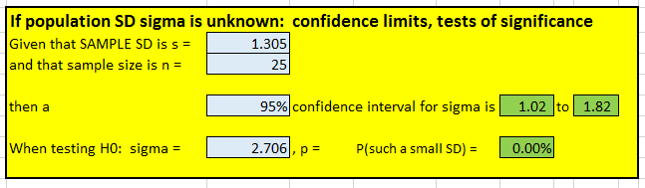
Inference for population SD
An Excel tool has been created to perform inference for the population standard deviation

Slide 70
BMI’s for 25 Marvel superhero females had SD was s_{f} = 1.305
The 95% conf. interval for σ_{f} is 1.02 to 1.82
We reject the hypothesis that σ_{f} = 2.706 (observed SD for Marvel superhero males)
One potential objection to comparing σ_{f} to 2.706: the SD of 2.706 is an estimate based on a sample of 25 Marvel superhero males
How do we compare two unknown population SD’s?

Slide 71

Next Time: Lecture 9
Inference with F distribution

Slide 72

Case Study
“Odors and consumer behavior in a restaurant”

Slide 73
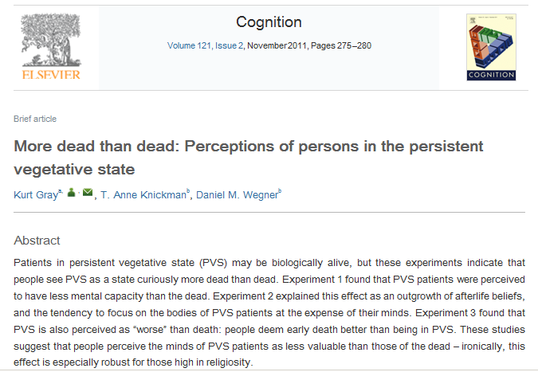
Case Study
“More dead than dead”

Slide 74


Science, 8 September 2006
Case Study
“Washing Away Your Sins”

Slide 75
http://pollingreport.com/immigration.htm
CBS, Aug 2017, equivalent to a simple random sample of n = 1111 U.S. adults
“Do you favor of oppose building a wall along the U.S.-Mexico border to try to stop illegal immigration?”
334 R: 240 favor, 87 oppose, 7 unsure
429 D: 39 favor, 378 oppose, 12 unsure
348 I: 121 favor, 214 oppose, 13 unsure

Slide 76
An experiment was conducted in which “sports fans” were shown one of two images
The height of the players was randomized
Judged as fouled 8 / 35 Judged as fouled 38 / 85
Are the rates the same, or did height matter?

Slide 77
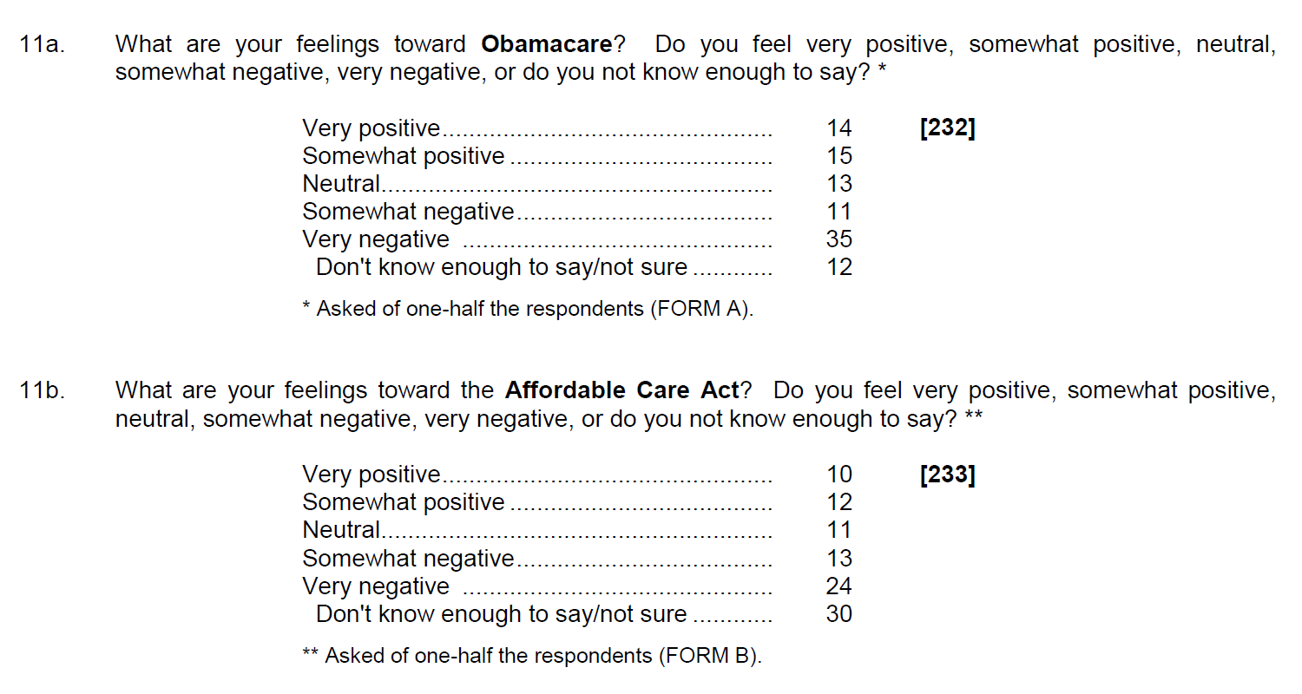
http://www.cnbc.com/id/101064954
In a September 2013 poll of 812 people, half were asked if they support Obamacare, and the other half were asked if they support the Affordable Care Act.

Slide 78
CBS News / NYT poll, 11 Jan 2009:
“All things considered, in our society today, do you think there are more advantages in being a man, or more advantages in being a woman, or [neither has advantage]?”
n = 561 men, 325 said “neither”
n = 551 women, 253 said “neither”

Slide 79
Quiz One, USC BUAD 310, Fall 2008
The same question was asked, but the choices were given in different order
A: “Controlled Experiment” or “Observ. Study”
B: “Observ. Study” or “Controlled Experiment”
Results: 80% of students answered correctly
28 out of 30 getting Form A answered correctly
21 out of 31 getting Form B answered correctly

